Slide 1
Impact of Social Sciences, Humanities and Arts Conference
The Parallel Session on:
Collaborations to Address Grand Societal Challenges
15 October, 2021

Slide 2
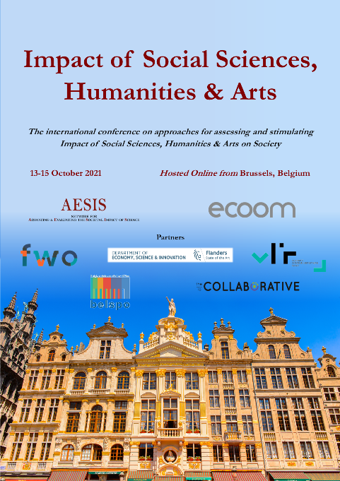
Impact of Social Sciences, Humanities and Arts
13-15 October, 2021
Wendy Steele (Chair): Associate Professor, School of Global, Urban and Social Studies, RMIT University, Australia
André Martinuzzi: Head of the Institute for Managing Sustainability, Vienna, Austria
Overview of the Speakers
#SSHA21

Slide 3
Impact of Social Sciences, Humanities and Arts
13-15 October, 2021
Wendy Steele
Associate Professor, School of Global, Urban and Social Studies, RMIT University, Australia
#SSHA21

Slide 4
A/Professor Wendy Steele

Slide 5
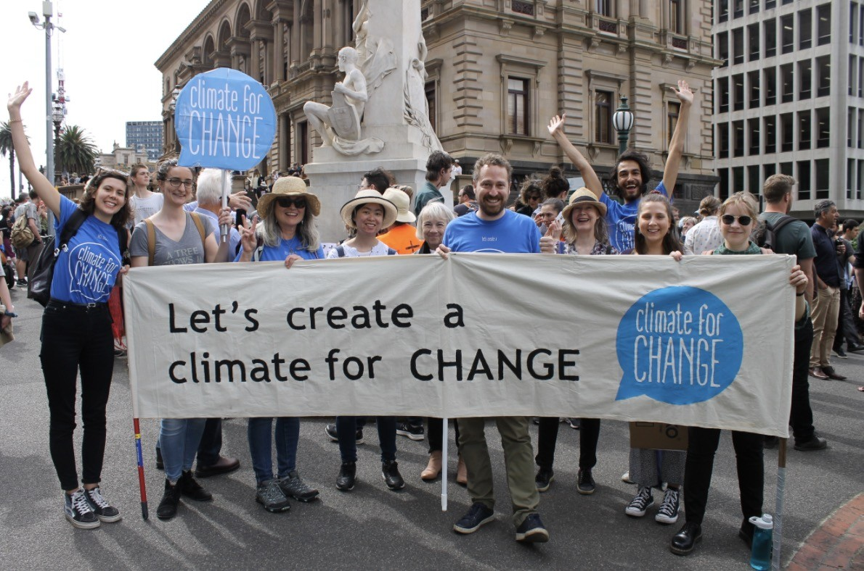
A disrupted, challenging world
Now more than ever it is clear we cannot neglect our global context, including transboundary risks that play out at the local scale.

Slide 6
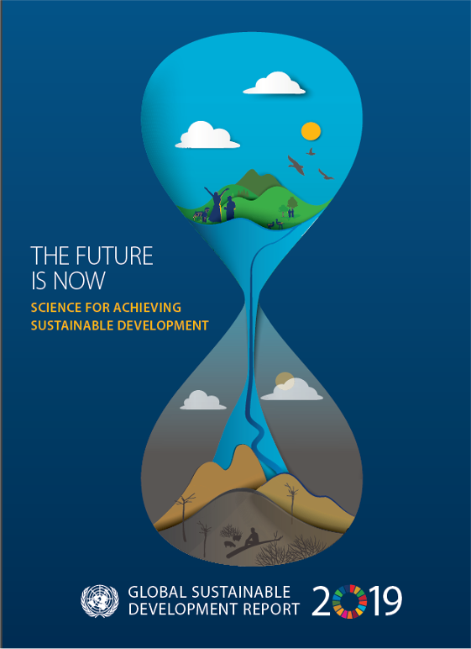
How are we going? What do we need?
2019 Global Sustainable Development Report
Concludes: ‘the current development model is not sustainable, and the progress made in the last two decades is in danger of being reversed…’
Identifies food, water, energy and urban systems as key arenas for change

Slide 7
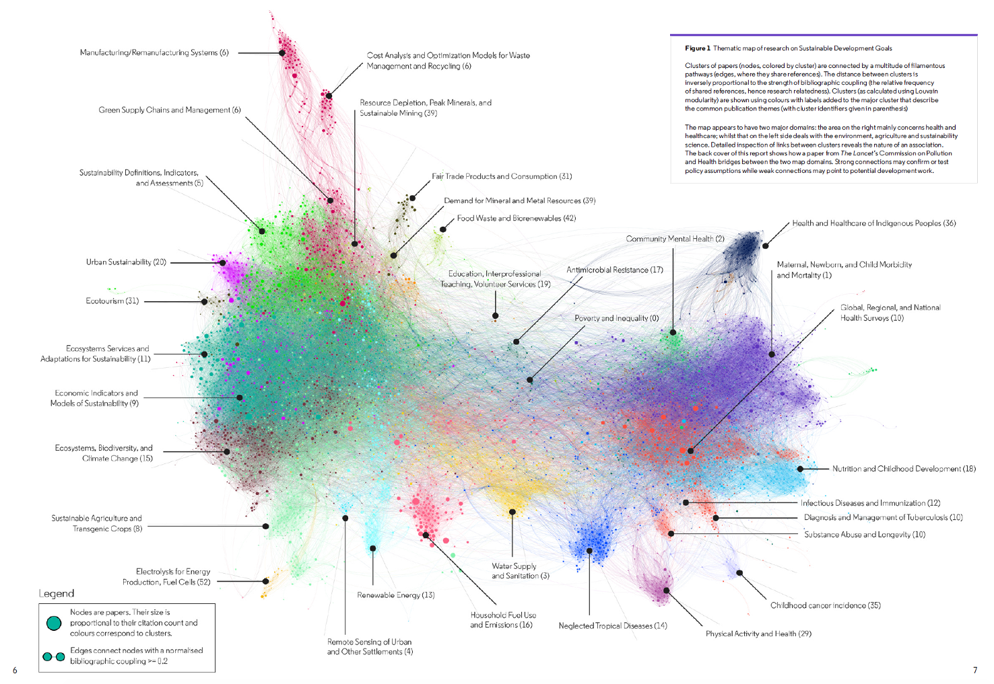
MATERIALS
HEALTH
FOOD
ENERGY
WATER
https://clarivate.com/webofsciencegroup/wp-content/uploads/sites/2/dlm_uploads/2019/07/Navigating-the-Structure-of-Research-on-Sustainable-Development-Goals.pdf

Slide 8
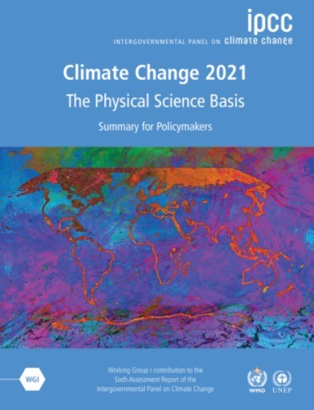
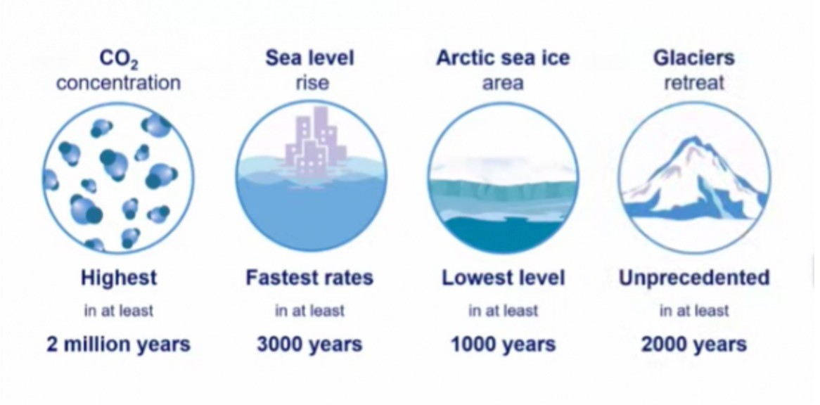
RMIT Classification: Trusted

Slide 9
Expectations of today’s universities
Uni's
SOCIETY
Uni's
SOCIETY

Slide 10
Universities as places of paradox
Tradition and radical change
Wealth and financial precarity
Inclusion and exclusion

Slide 11
What problems? What futures?
What collaborations?
Future-ready graduates able to make a substantial contribution
Impactful research providing positive solutions to real world problems
A genuine practical commitment to engagement and collaboration

Slide 12
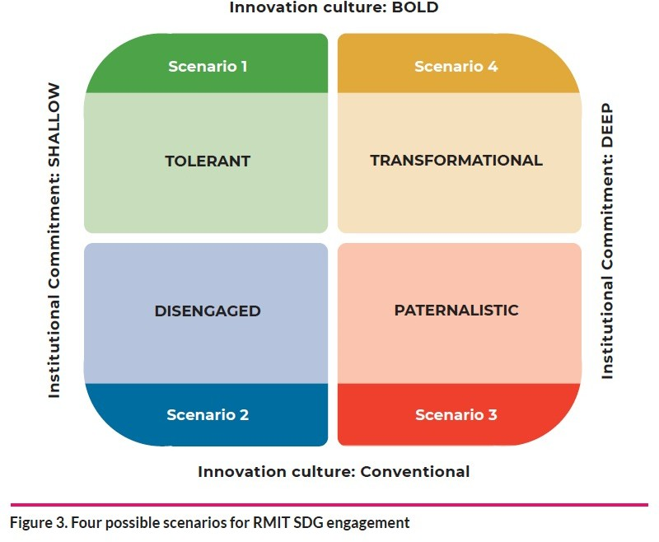
and ETHICAL
(

Slide 13
Ethical innovation
RESPONSIBLE
– ANTICIPATORY
INCLUSIVE
- COLLABORATIVE AND SYSTEMIC
DISRUPTIVE
- BOLD AND
ENGAGED
– PURPOSEFUL AND RESPONSIVE
(Rickards and Steele 2019)

Slide 14
Rethinking our approach to impact -
Is it up to the task?
https://cur.org.au/project/rethinking-research-impact/

Slide 15
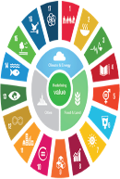
Drivers of the Research Impact agenda in universities
Economic justification of research spending
Implicit social contract of universities
Boundary-crossing between universities and the rest
Focus on economic development
Sense that nations need innovation not research per se
Research is costly – need to justify spending
Concern about deepening grand challenges, including inequalities
Call on universities and researchers to do their bit
Focus on making research count – making it relevant, usable and legitimate as well as rigorous
Blurring of distinctions between university, business and society
Normative turn to coproduction of knowledge ( ‘Mode 2 science’)
Awareness of need to distinguish and justify universities’ role

Slide 16
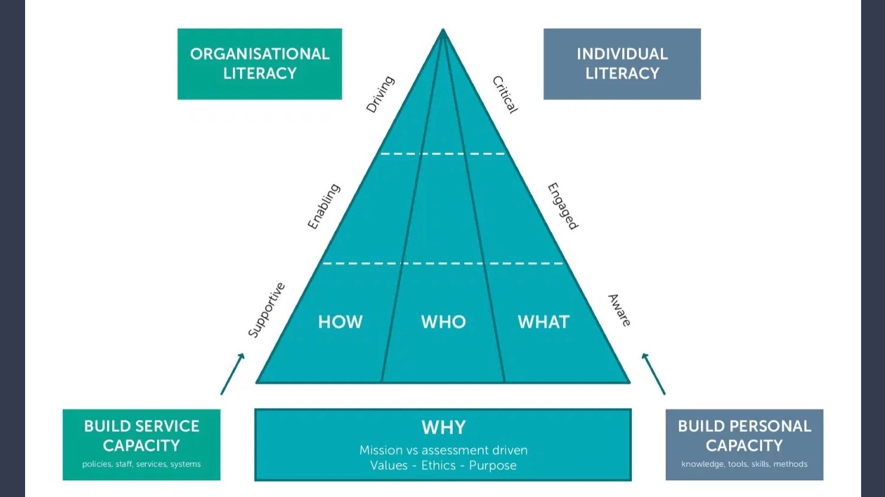
https://juliebayley.blog/impact-literacy/

Slide 17
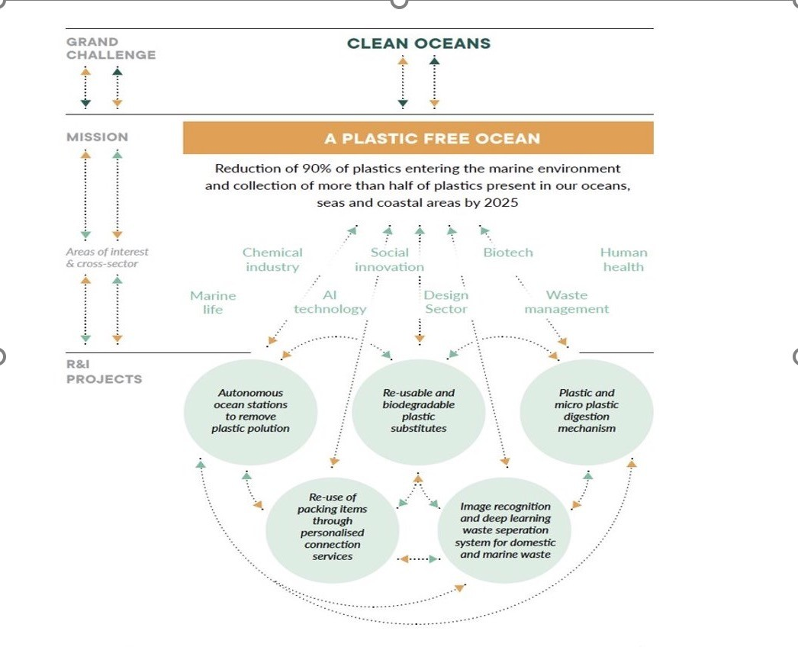
Mazzacuto, 2018

Slide 18
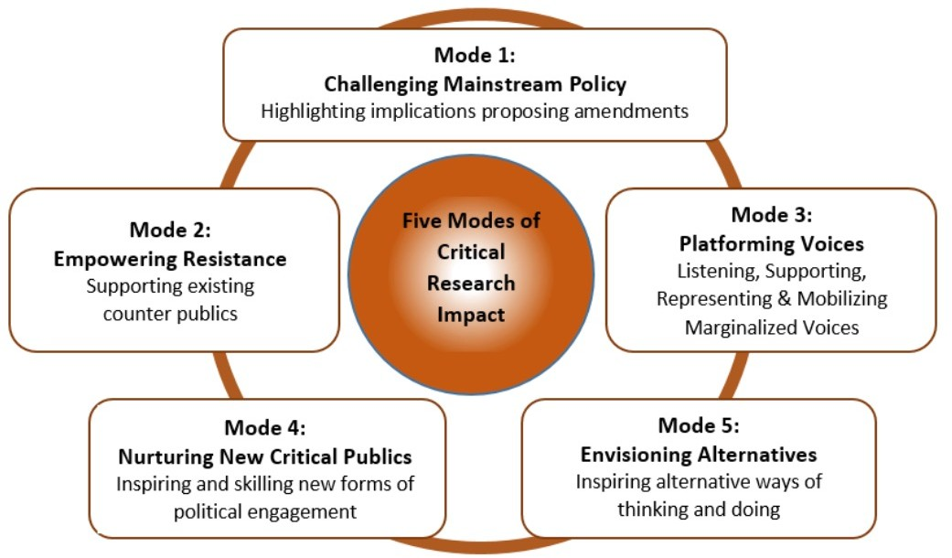
RMIT Classification: Trusted
Machen, 2018

Slide 19
3 Generations of research impact
16

Slide 20
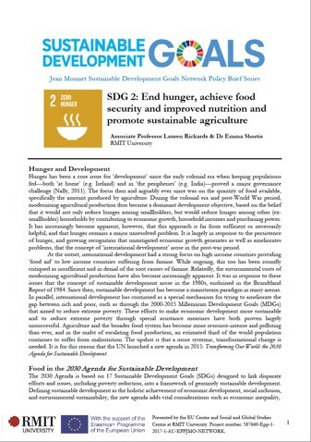
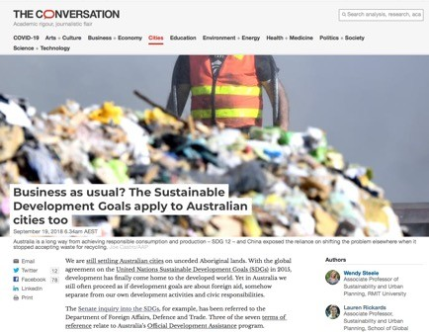
Examples of research translation
Implications for HDR training
cultivate skills and opportunities to communicate research findings

Slide 21
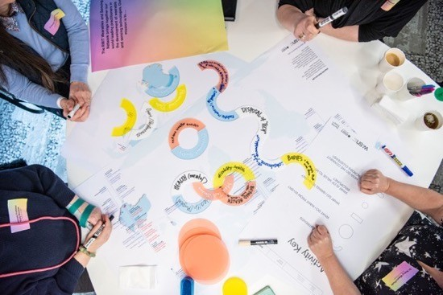
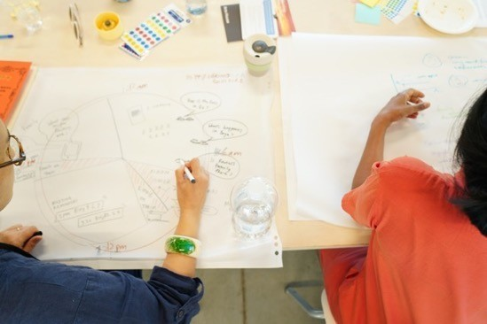

Slide 24
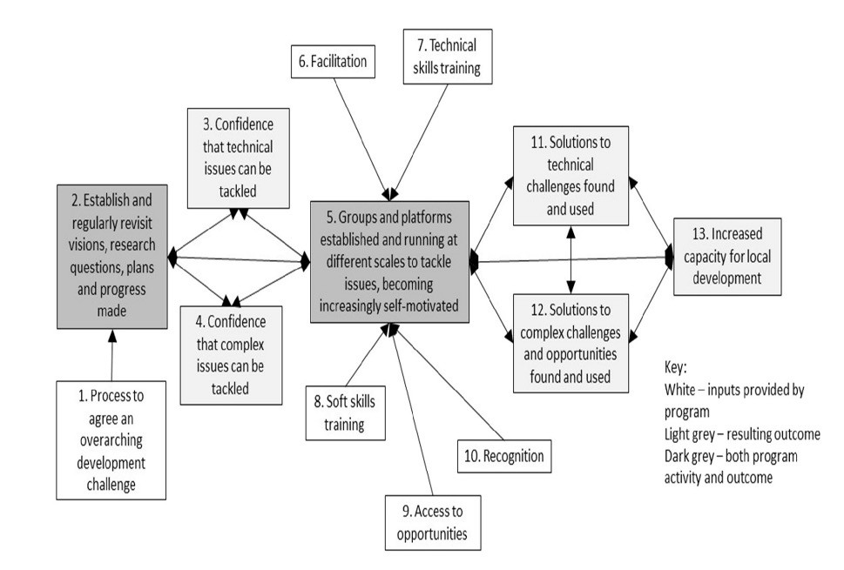
A Third Gen approach is “complexity aware”, recognising the uncertainty of outcomes in a dynamic world, need for adaptability, the continuous nature of impact, and the possibility of unintended impact.
Douthwaite and Hoffecker (2017)’s complexity aware Theory of Change for sustainable development challenges

Slide 25
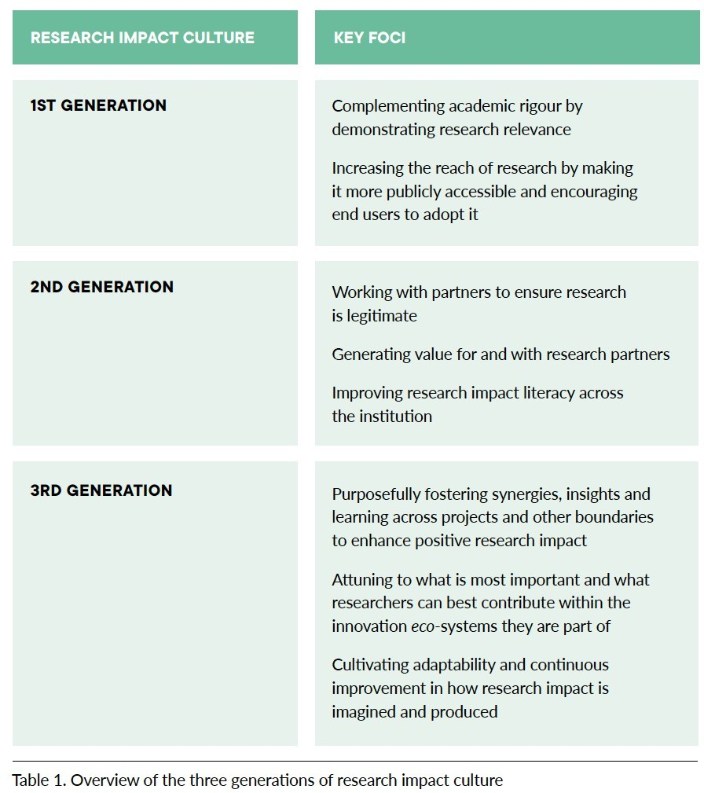

Slide 26
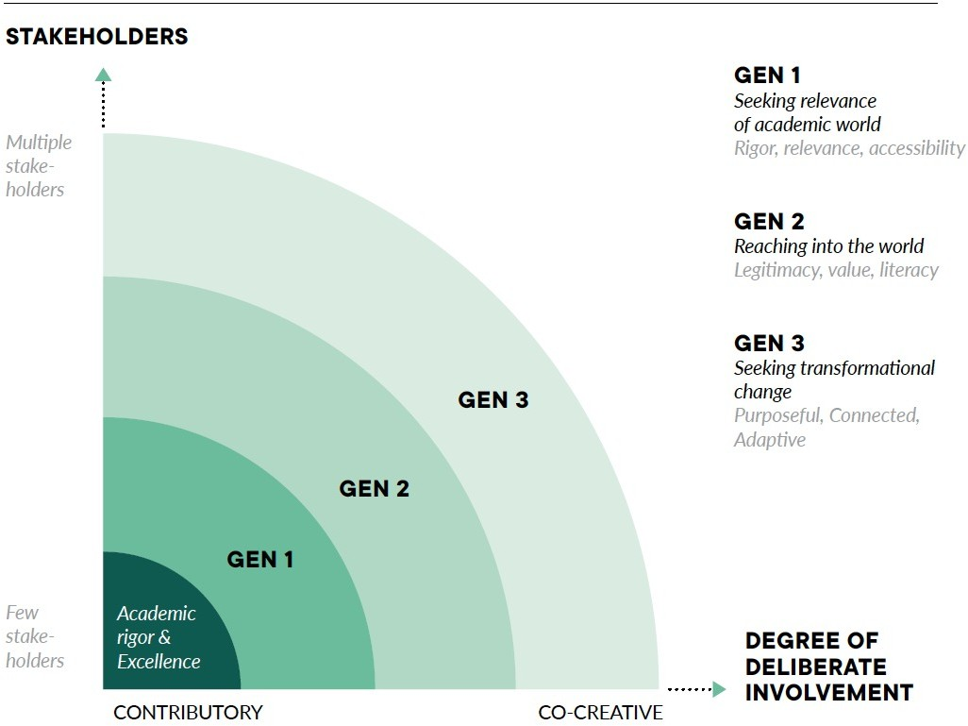

Slide 28
A/Professor Wendy Steele

Slide 29
Impact of Social Sciences, Humanities and Arts
13-15 October, 2021
André Martinuzzi
Head of the Institute for Managing Sustainability, Vienna, Austria
#SSHA21

Slide 30
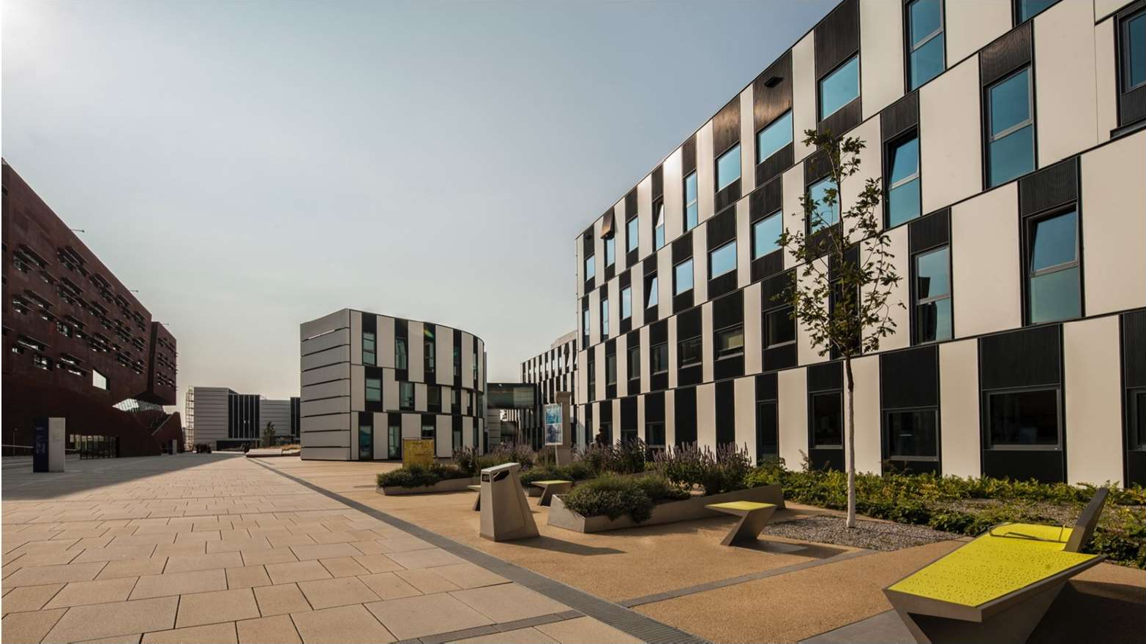
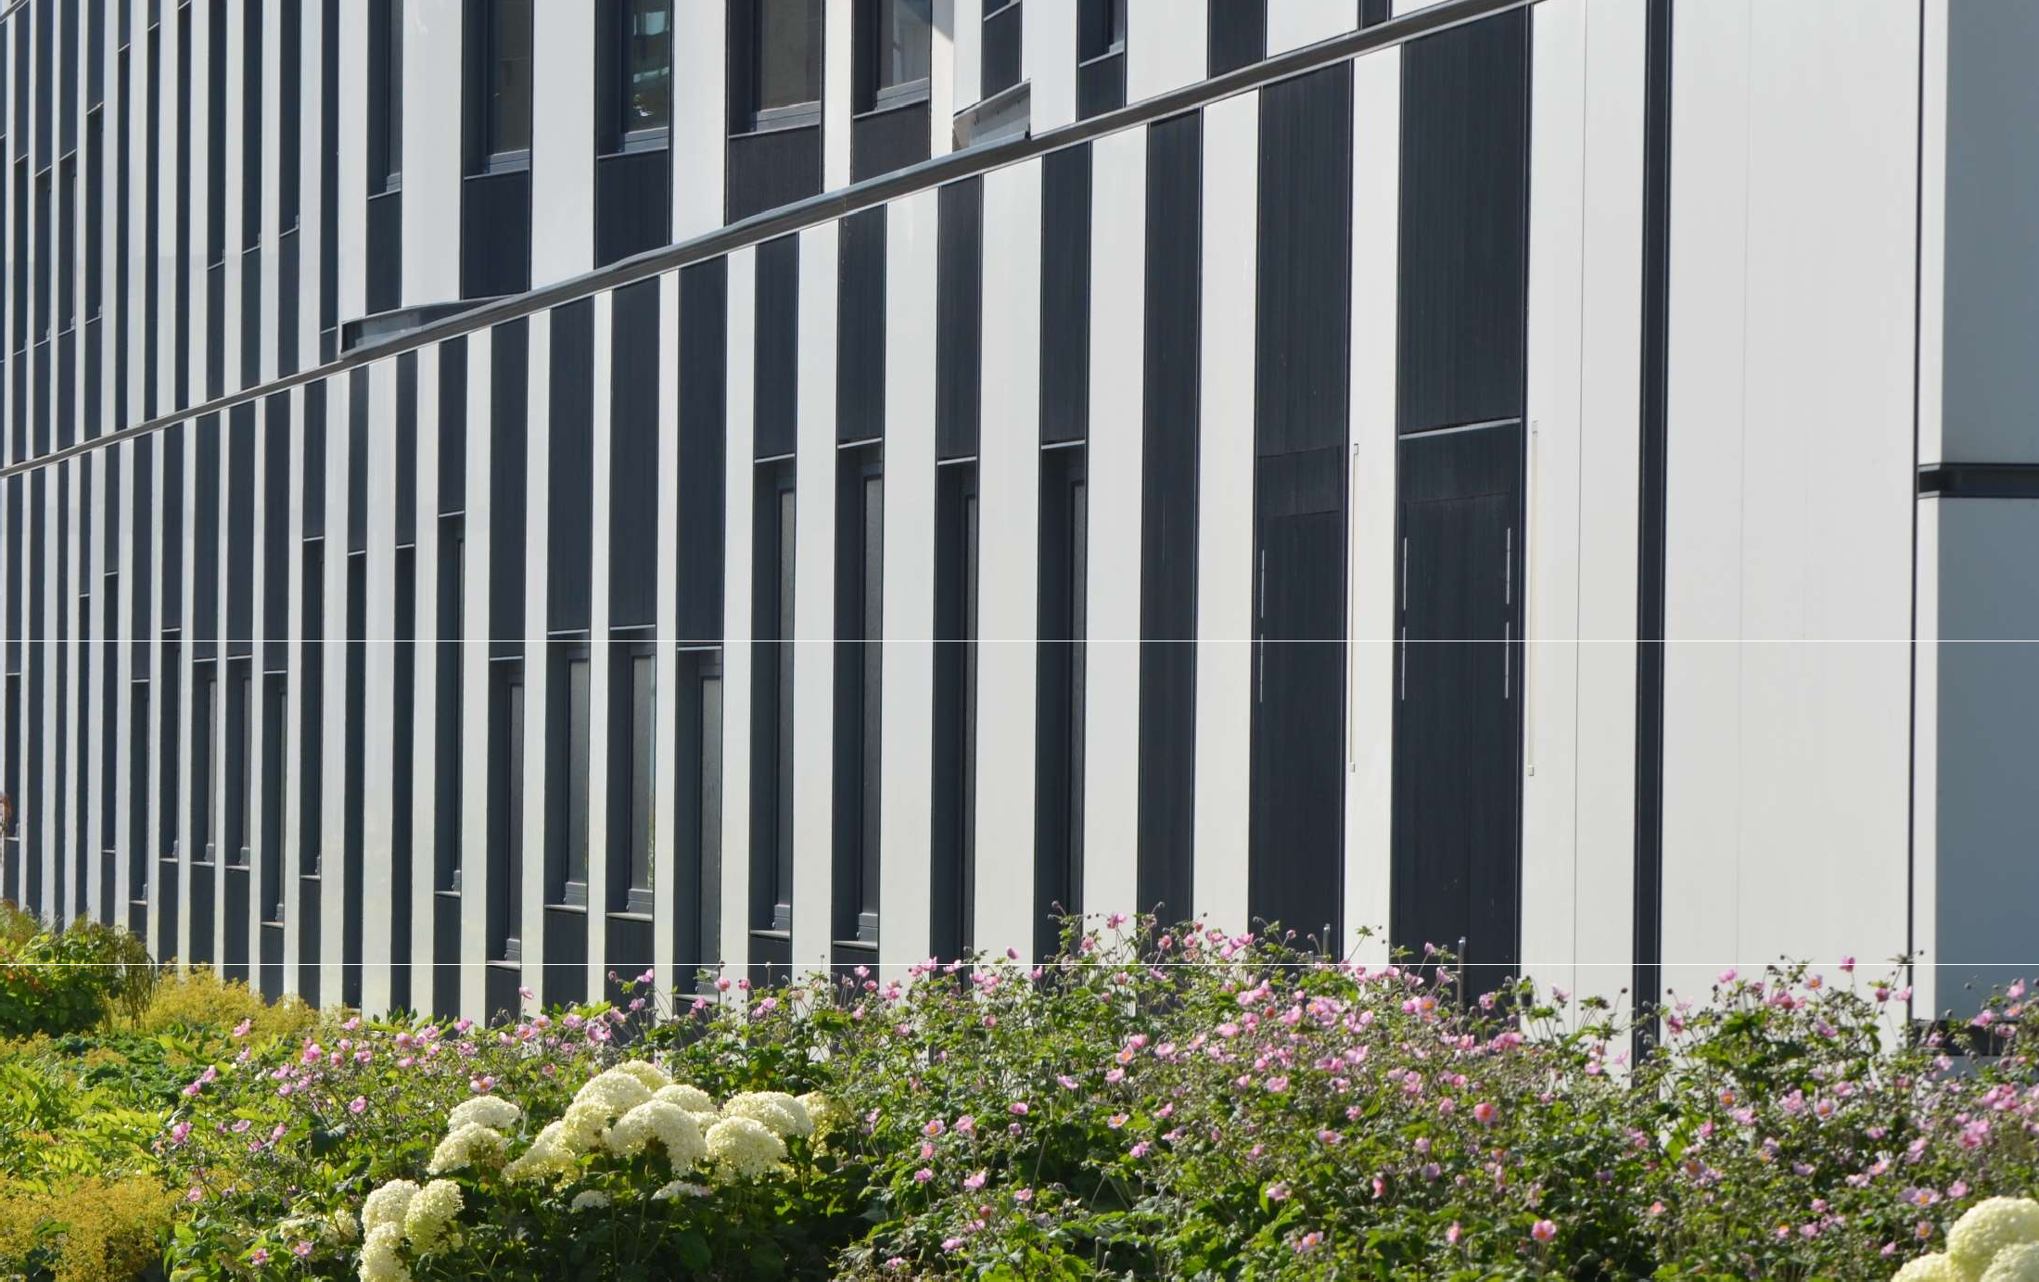
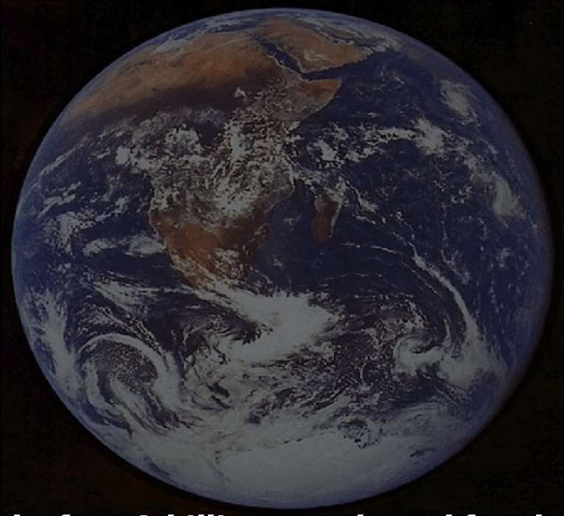
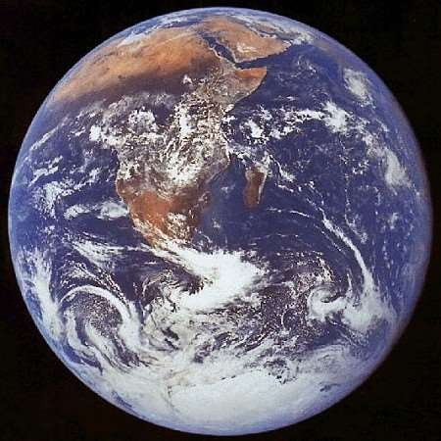
14.10.2021
Sustainability, Responsibility and Innovation
André Martinuzzi
Head of the Institute for Managing Sustainability and Associate Professor at WU Vienna
www.sustainability.eu
What is “sustainable” … ?
… whatever works for 10 billion people and for the next 500 years (technologies, products and services, consumer behaviour, practices)

Slide 31
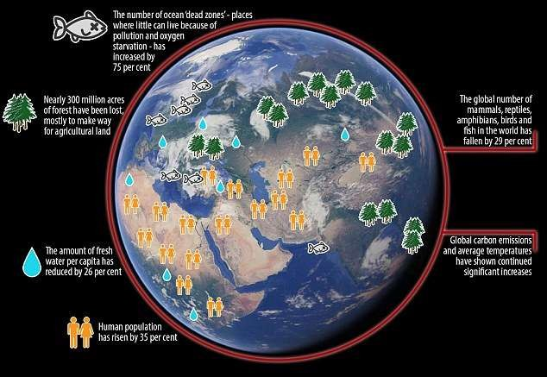
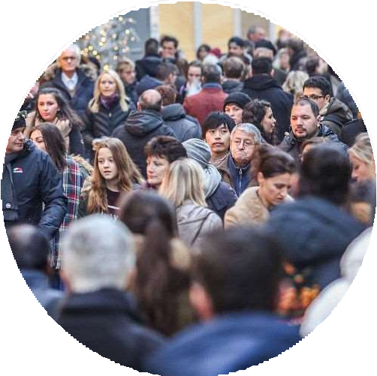
14.10.2021
Trend 1: We encounter the 6th mass extinction
Ocean Dead Zones
increased by 75%
Deforestation of the size of South Africa
58% loss of biodiversity since 1970
26% less fresh
water per capita since
1992
Human population
increased by 35%
since 1992
Global CO2 Emissionen increase continuously
World Scientists’ Warning to Humanity
(13. Nov. 2017, 15,000 signatories from all ends of the earth)
Trend 2: People lose trust all around the world

Slide 32
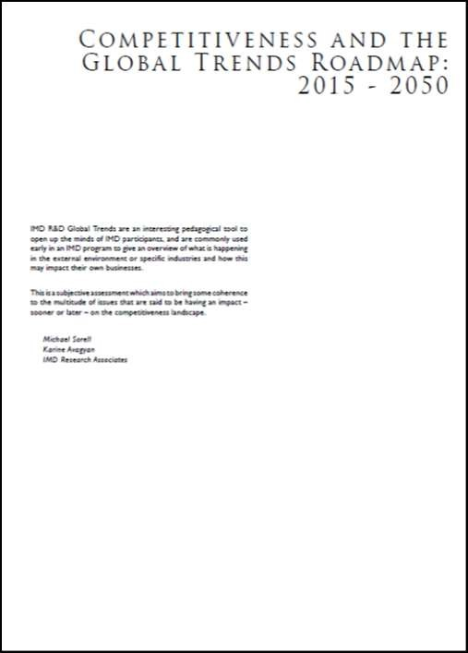
14.10.2021
Trend 3: From innovation landscapes to systems
We are at the beginning of a global transformation characterized by the convergence of digital, physical, and biological technologies in ways that are changing both the world around us and our very idea of what it means to be human.
This transformation is not defined by any particular set of emerging technologies themselves, but rather by the transition to new systems that are being built on the infrastructure of the digital revolution.
How do companies understand their responsibility
a. Philanthropy
… we do not learn anything from donating money
b. Eco-Efficiency
… we harvested all the low hanging fruits
c. Management Systems
… its quite bureaucratic
d. Product Differentiation
… there are no empty niches left
e. Responsibility for Impacts
… we struggle with this complexity
f. Responsible Innovation
… sounds interesting – tell me more …

Slide 33
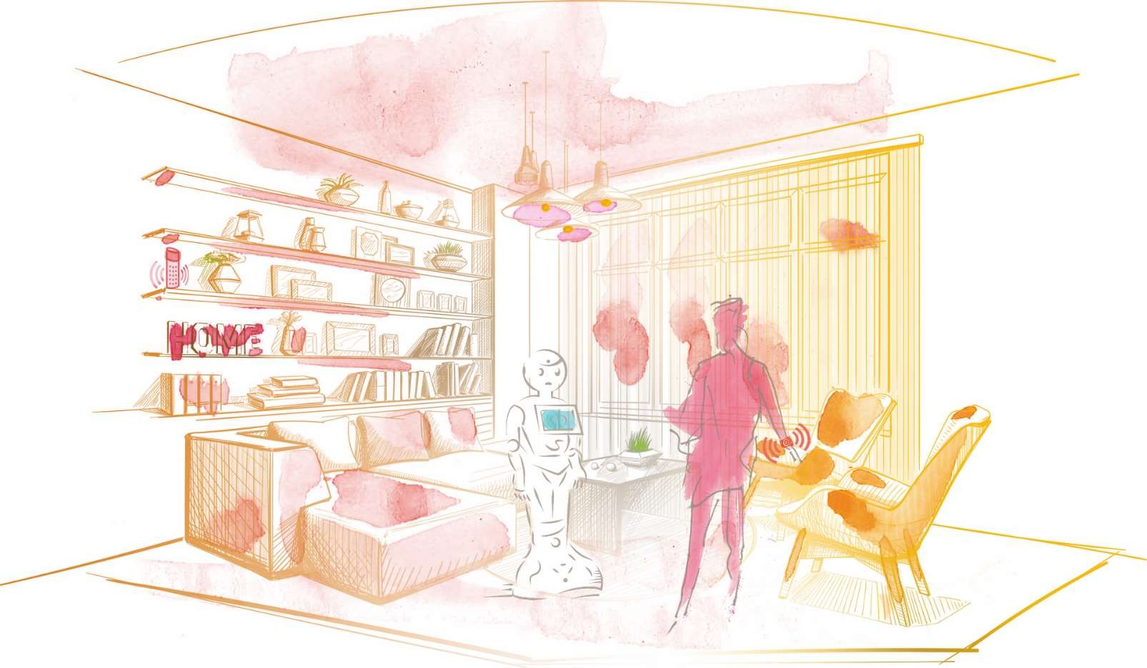
14.10.2021
Responsible Innovation
c r e a t e s n e w b u s i n e s s o p p o r t u n i t i e s
LIVING INNOVATION is the first industry driveninitiative on responsible innovation funded by the European Union.
It was started by 14 partners from industry, civil society and research and involves major companies of theICT and the health care sector.
We joined forces to co-create moreresponsible approaches to innovationin the area of smart homes and smart health.
CO- CR EATING THE WAY WE WILL LIVE IN 2030
CO- CR EATING THE WAY WE WILL LIVE IN 2030
CSR as a starting point
CSR
key for societal acceptance
links to global SD goals (SDGs)
stakeholder approach
A broader view
Innovation
Aligning business interests and societal needs
key for competitiveness
technology & market driven
forward looking
Having real impacts and co-designing the future
A pro-active approach

Slide 34
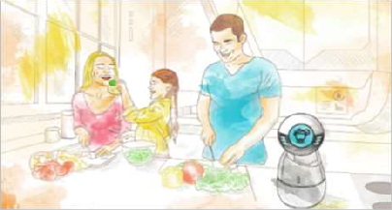
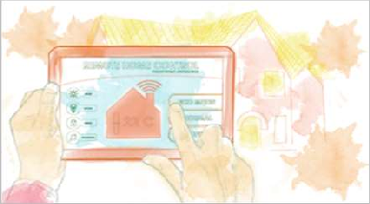
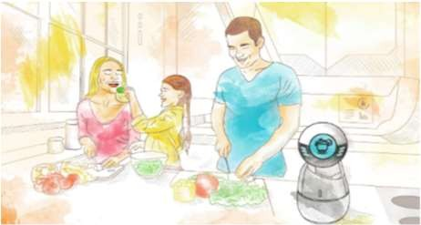
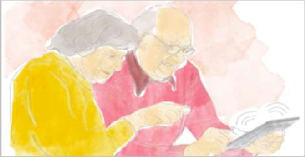
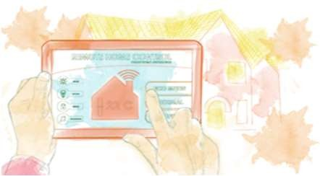
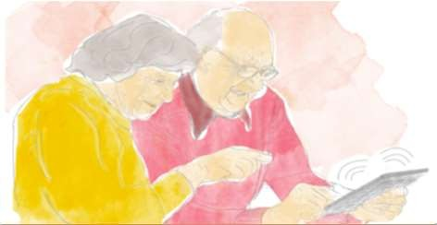
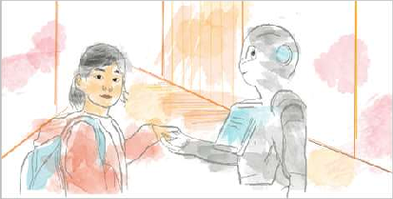
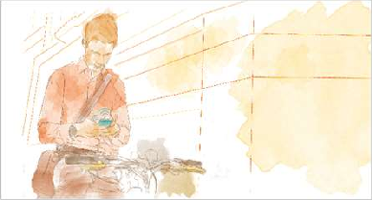
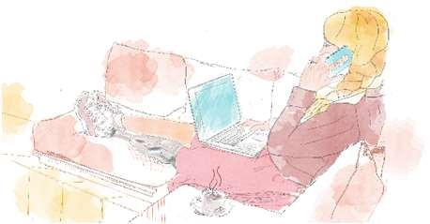
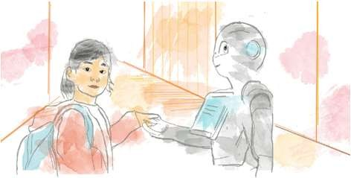
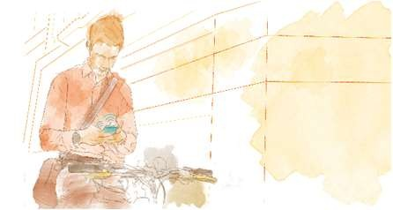
14.10.2021
Responsible Innovation
Responsibility | … for impacts | … towards stakeholders | … within systems
Innovate | … with purpose | … with people | … at a higher level
Business Case | Reduce risks and costs | More and better fitting ideas | Game Changers & Radical Innovation
Societal benefits | Avoid negative impacts | Priority setting & desirability | Resilience Sust. Transition
Concepts | Technology assessment | Open / social innovation | Innovation Eco-Systems
Responsible Innovation Labs
2019
F U T U R E H O M E S & L I F E S T L Y E S
I N T E R N E T O F T H I N G S I N D A I L Y L I F E
L I F E L O N G
H E A L T H & C A R E
2020
F I T N E S S & P R E V E N T I V E
H E A L T H C A R E
C O M M U N I T I E S & C O L L A B O R A T I O N
H I G H T E C H A T H O M E

Slide 35
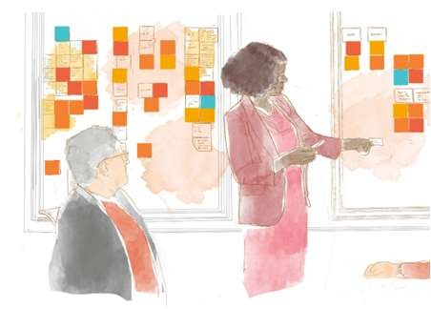
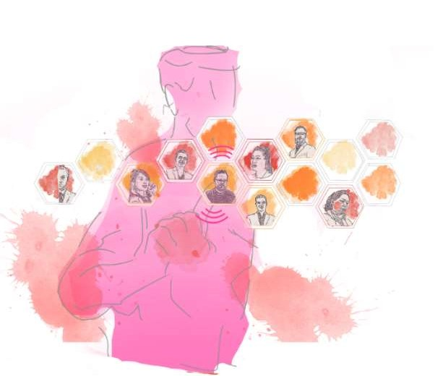
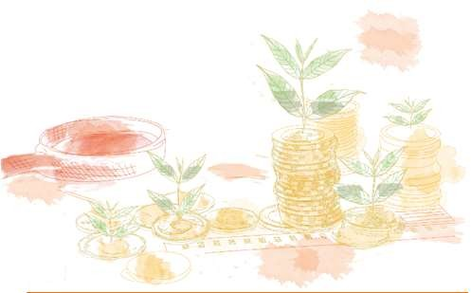
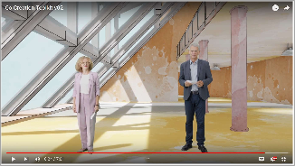
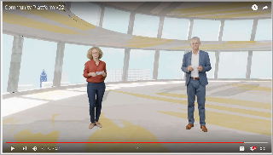
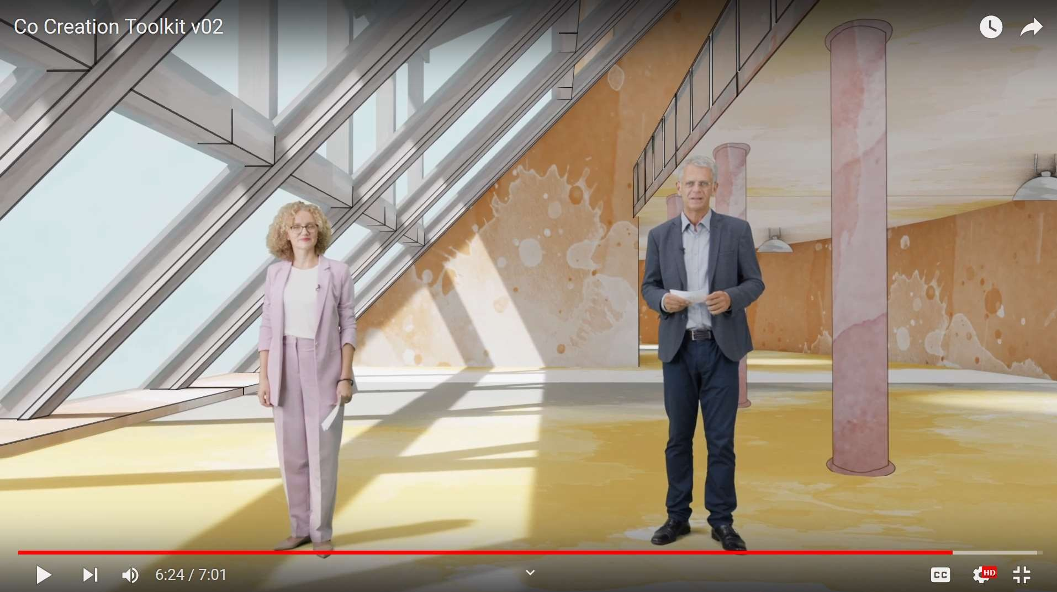
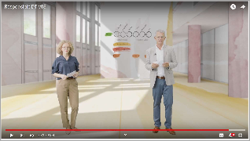
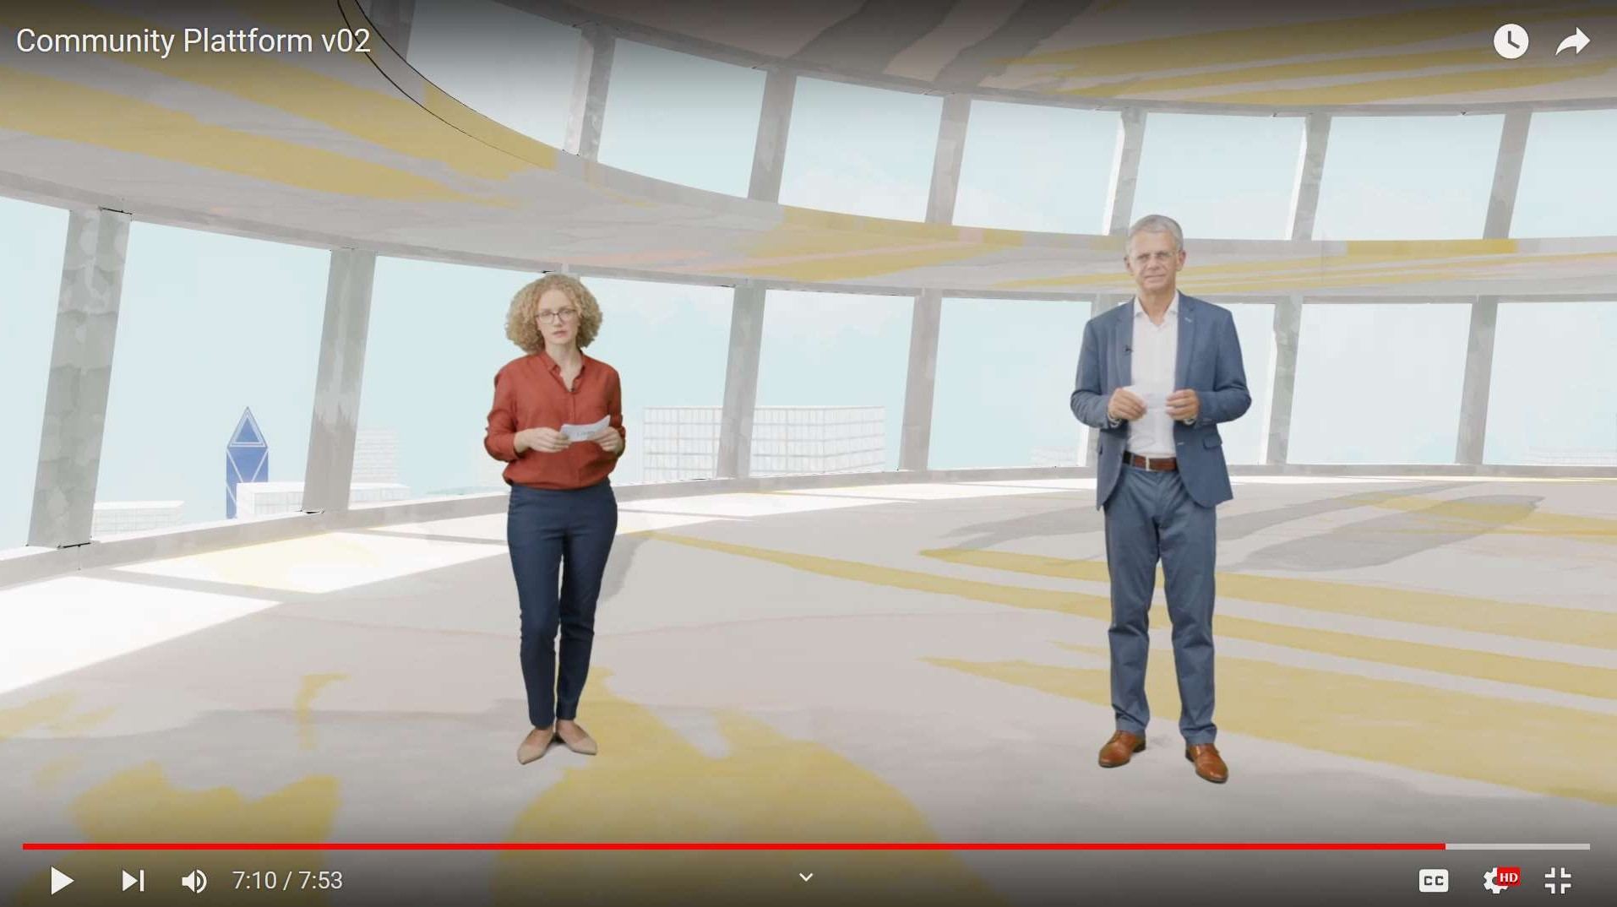
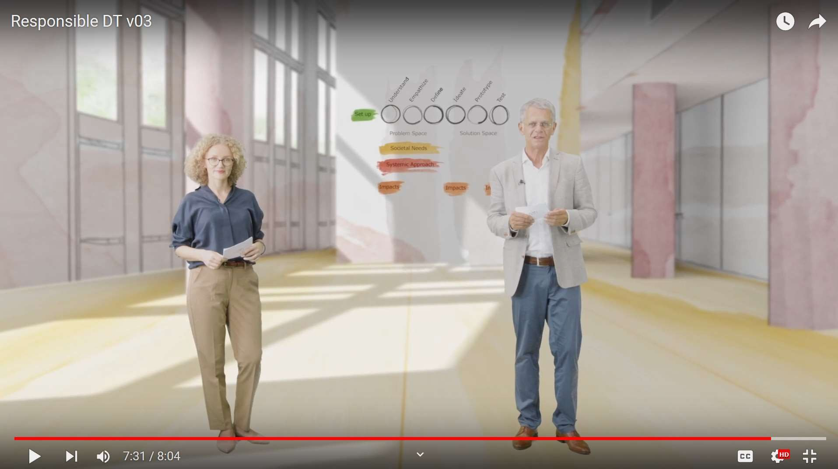
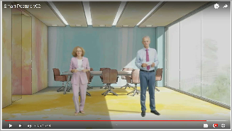
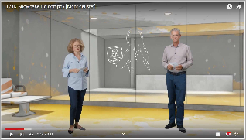
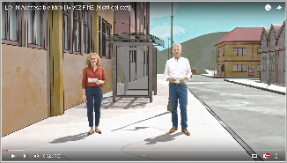
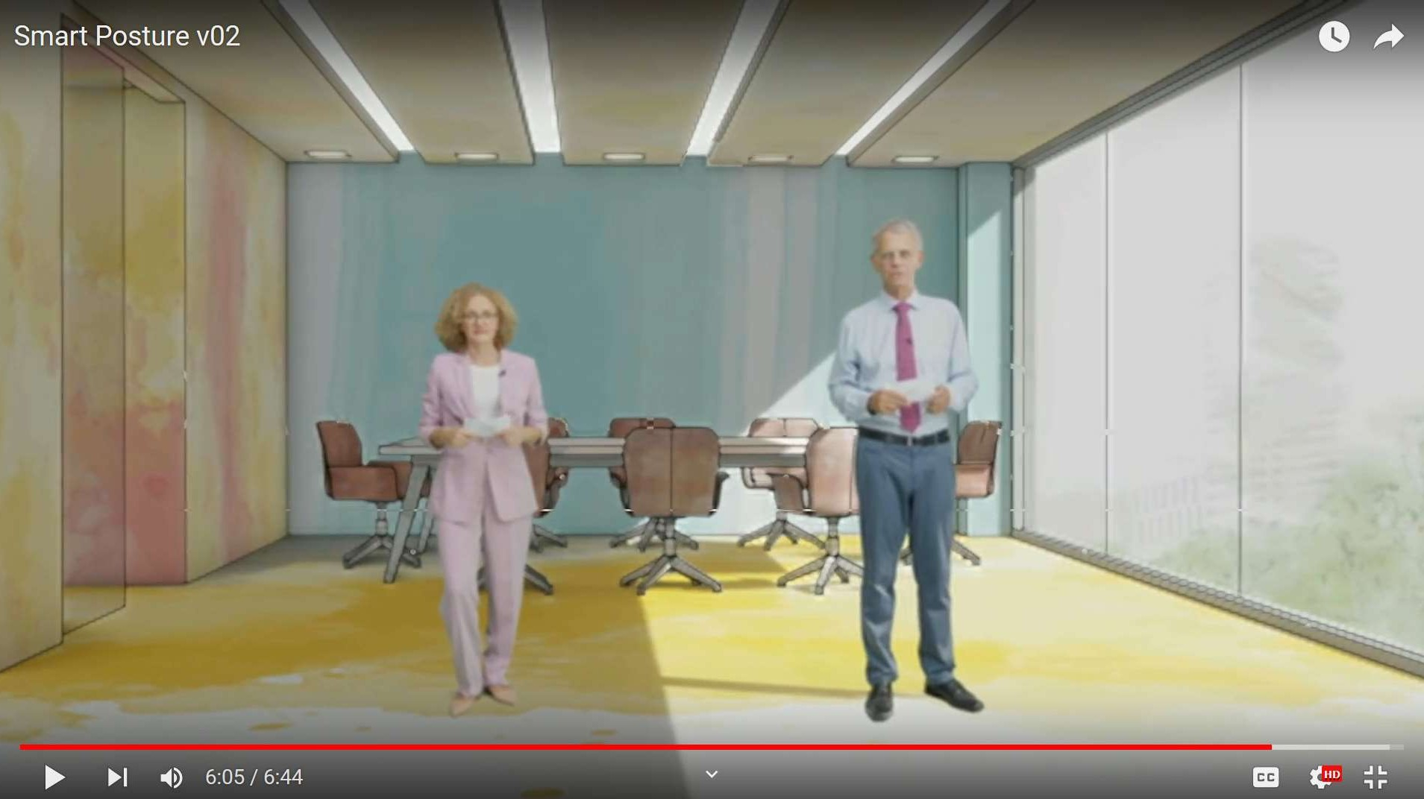
14.10.2021
Co- Creating Responsible Innovation
R E S P O N S I B L E
I N N O V A T I O N L A B S
V I R T U A L C O M M U N I T Y
P L A T F O R M
B L U E P R I N T S & S H O W C A S E S
R E S P O N S I B L E
I N N O V A T I O N L A B S
V I R T U A L C O M M U N I T Y
P L A T F O R M
B L U E P R I N T S & S H O W C A S E S
Explore www. living- innovation. net
Responsible Design Thinking
Platform for Amputees
Co-Creation Toolkit
Holography for Business
Smart Mobility
Smart Office Chair
Inclusive Innovation Workshops
Business Case for Respo Inno
XR in Training and Teaching

Slide 36
14.10.2021
Explore www. living- innovation. net
The LIVING INNOVATION project
u s e f u l e x p e r i e n c e s a n d d e l i v e r a b l e s f o r y o u
100 video interviews
20 webinars and online dialogues Responsible Innovation Showcases Guidance for workshops with blind people Co-creation Toolkit
Policy briefs Book Presentations

Slide 37
14.10.2021
Responsible Innovation
i n a n u t s h e l l
Consider future impacts of innovations
Innovate
with the people and for the people
Co-Design whole systems
WWW.LIVING-INNOVATION.NET
WWW.LIVING-INNOVATION.NET

Slide 38
Impact of Social Sciences, Humanities and Arts
13-15 October, 2021
Thank you!
#SSHA21

